Slide 1
How to install Z83 sample solution
Prerequisite know of Model Driven Power Apps, Microsoft Dataverse and Power App Portals / Power Pages is needed in order to install, configure and customise this sample solution

Slide 2
Overview
Install solution file
Import configuration data
Create blank portal, Import portal records
Configure cloud flows
Configure / add master data
Permission Setup

Slide 3
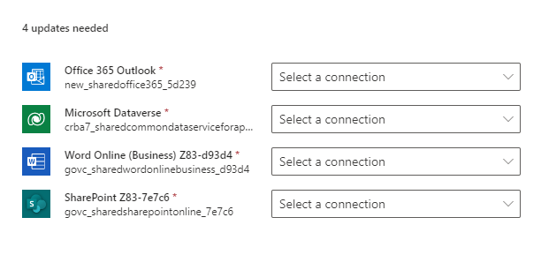
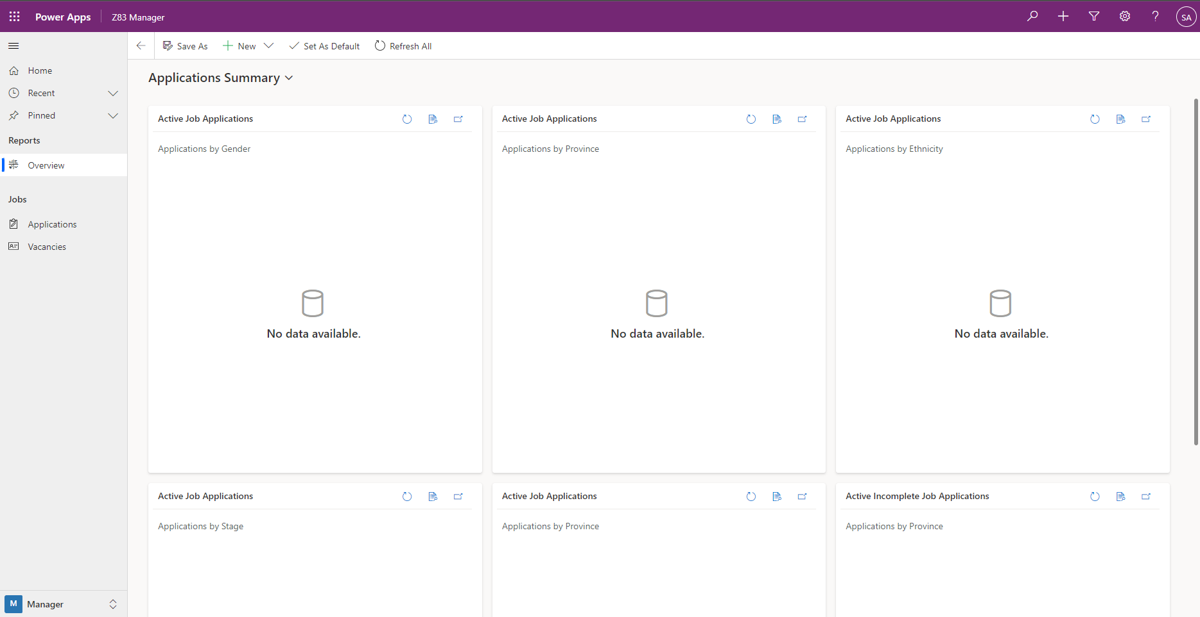
#1 – Install Solution File
Both managed and unmanaged version of solution file provided
Choose your flavour
You need to know the difference and impact of which one you choose. If you are not familiar with these concepts, please do research and understand before choosing one
Import the solution file
During import it will ask for 4 connections.
Office 365 Outlook (so that the cloud flows can send emails to applicants)
Microsoft Dataverse (cloud flows connect to Dataverse)
Word Online (cloud flow which converts Word template to Word document to generate Z83 document, save as PDF)
SharePoint Online (cloud flow references Word template and saves Word document to SharePoint library)
Validate this has worked by opening the Z83 Manager Model Driven application

Slide 4
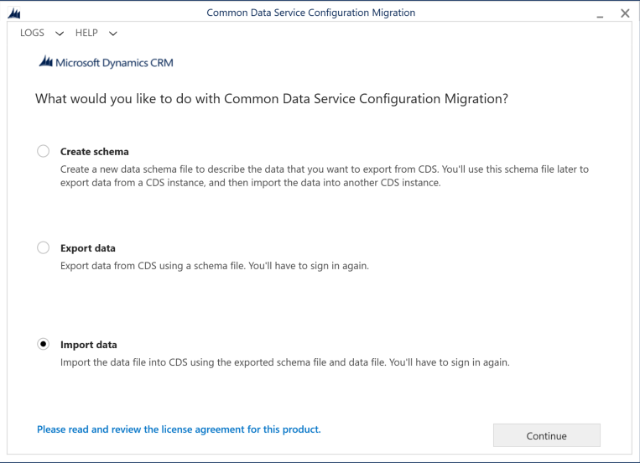
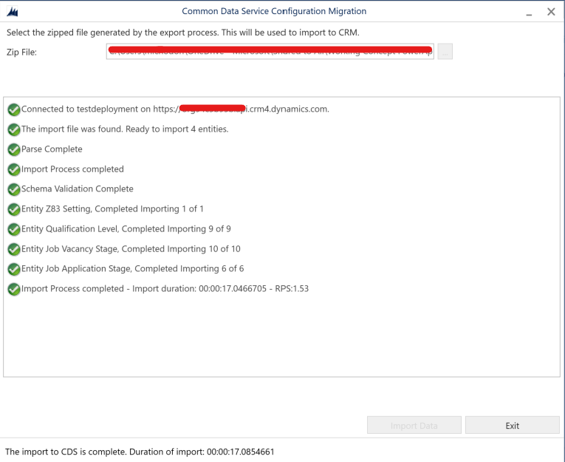
#2 – Import Configuration Data
This will deploy settings and sample master data such as vacancy stages, qualification levels and more. You can always change this master data later.
This data is deployed by using the Configuration Migration tool
Download the Configuration Migration tool
Run Configuration Migration (datamigrationutility.exe) and connect to your destination environment
Select the configuration data ZIP file
Validate this has worked by checking that master data is now in the settings section of the Z83 Manager application. You should now have vacancy and application stage records and a single settings record

Slide 5
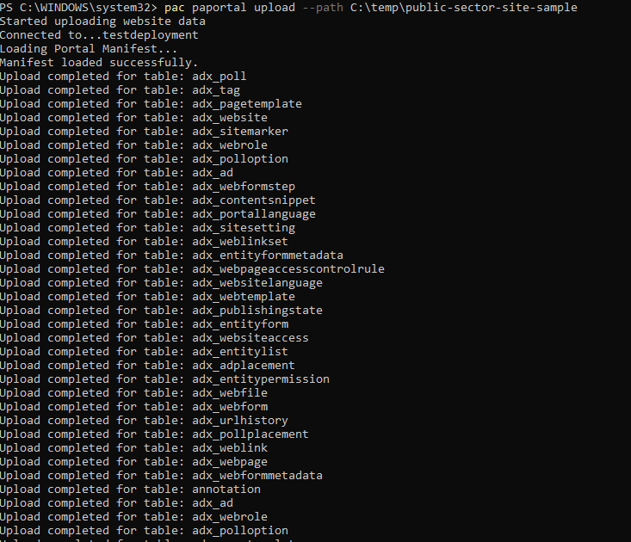
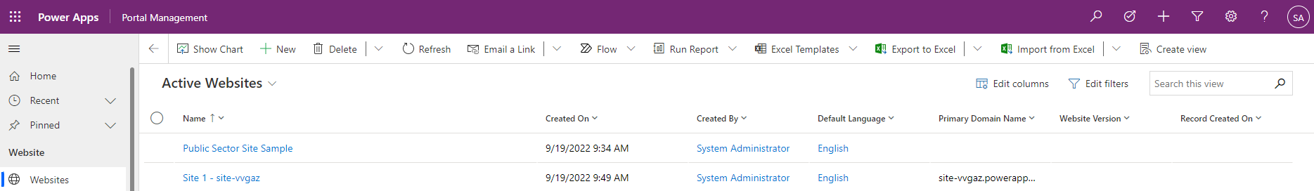
#3 – Create and Update Portal
Create a blank Portal in your destination environment
Preferred through https://make.powerpages.microsoft.com
Ensure portal exists and deployment is complete before proceeding
Create a new web site by importing the Public Sector Sample portal provided (ZIP file)
Extract the ZIP file to a temporary folder e.g. c:\temp\public-sector-site-sample\
You use the PAC Command Line Interface to add these records. The PAC command line understands nuances related to deployed Portal records, and so this is the preferred method
Download PAC Command Line Interface tool here - https://aka.ms/PowerAppsCLI
This article documents the steps to export and import portal records. In your case you are importing (uploading) only.
Example to upload once you have authenticated via “Pac Auth” and set index to portal (read article to see how to do this):
pac paportal upload -p “c:\temp\public-sector-site-sample”
Open Portal Manager and verify you have a new web site called “Public Sector Site Sample”
Use Power Apps Maker portal (make.powerapps.com), select the portal created in step 1, and select to administer it. (screen shots shown on next slide)
In the web site drop down, select the web site imported i.e. Public Sector Sample Site. Essentially you are associating the portal create in step 1 with the new imported site.
Browse the portal and validate it has the pages needed e.g. jobs
You may need to delete a few pages which are not relevant e.g. Tender pages, as the Tender solution is not installed

Slide 6
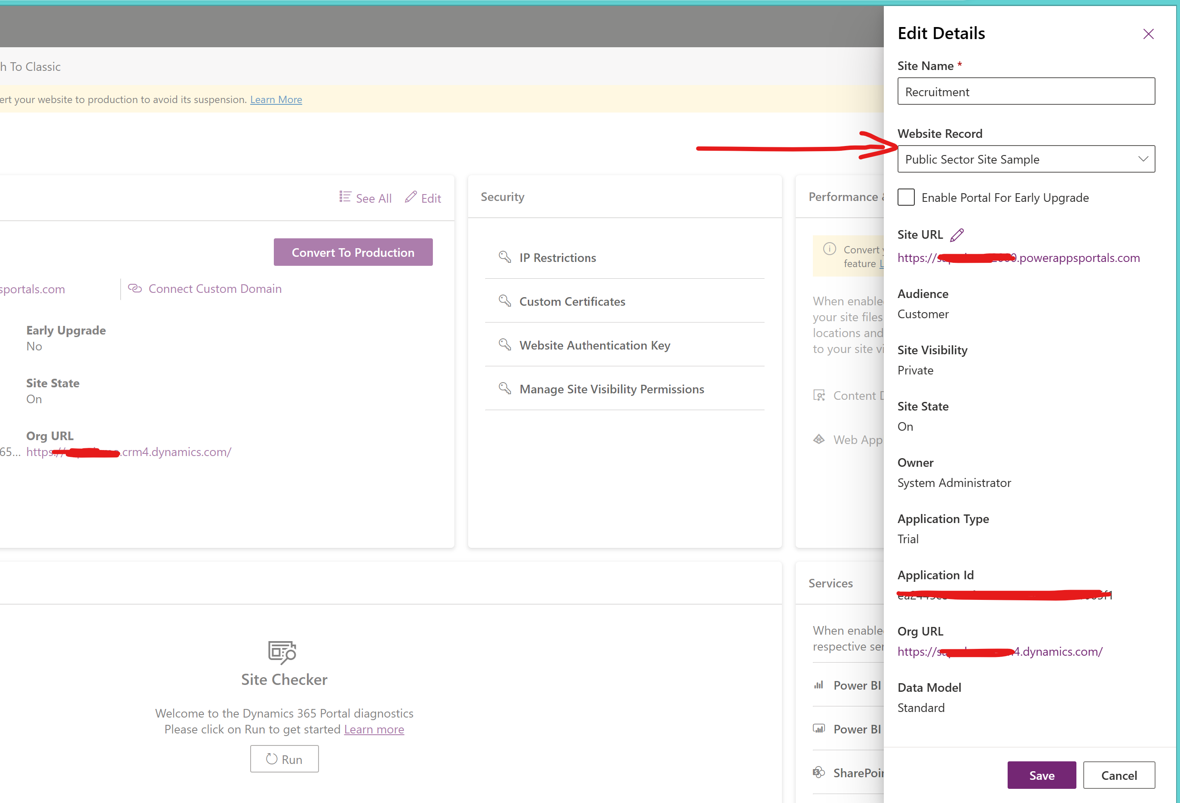
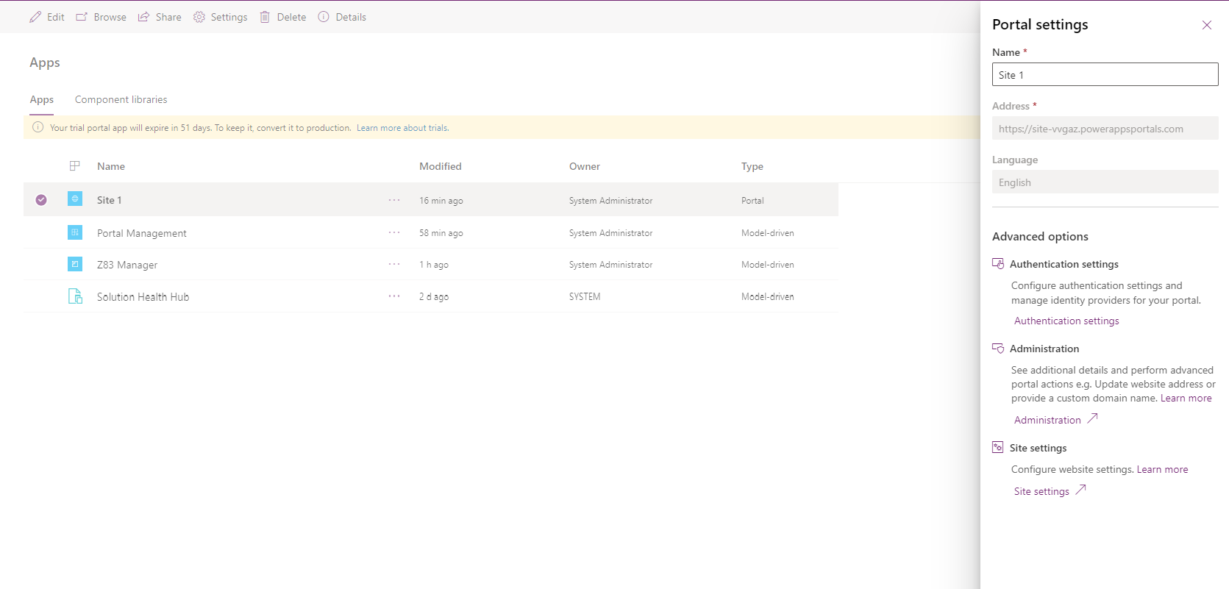
#3 – Create and Update Portal

Slide 7
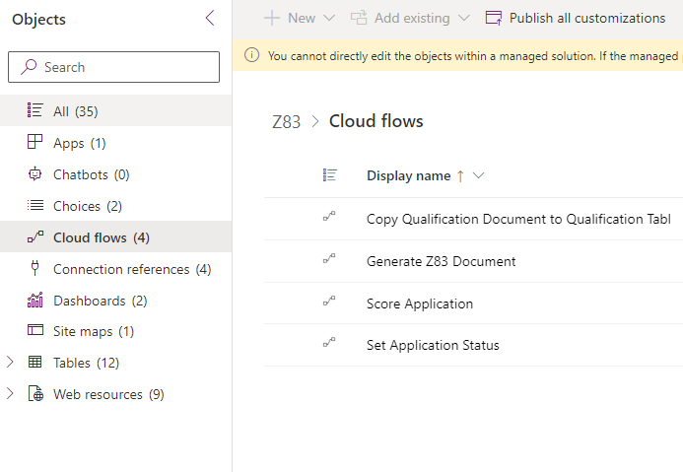
#4 – Configure Cloud Flows
4 Cloud Flows, only 1 must be edited.
Generate Z83 Document
Flow runs when new application is created (added)
Flow creates a Z83 Word document from a Word template, uses SharePoint library as temp location, converts Word document to PDF then copies to Dataverse application record
Must edit this flow to change path to SharePoint library in several action steps
Sends email to applicant, edit email body if needed
Set Application Status
Sets application record to inactive when the application stage is changed to a stage which is configured to mark the application as inactive
Nothing to change in this flow. However, you might want to edit which application stages should make the application record inactive. Done under settings -> Application Stages.
Copy Qualification Document to Qualification Table
Copies note attachment from proof of qualification portal form to the application Dataverse record.
No need to edit this flow, it should just work
Score application
This flow does nothing. It’s a place holder to add scoring logic if ever needed.
Example, based on application matching vacancy requirements and/or diversity requirements etc, the application could be scored and a score could then define the priority / sort on applications for a job vacancy
This flow is turned off by default

Slide 8
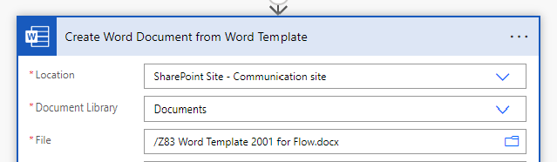
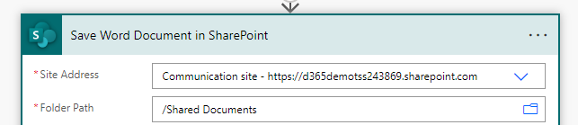
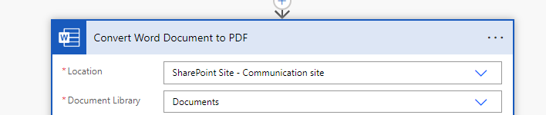
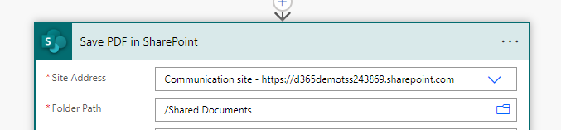
#4 – Edit Generate Z83 Document Flow
You need a SharePoint document library for 2 reasons
Hold the Z83 Word template, this is the template used to generate the Z83 Word document
Temp location where Z83 Word document is created, and PDF version saved.
These an be 2 different document libraries / locations / folders in SharePoint Online. Tip: create a folder for template and a folder for generated documents
Upload the provided Word template into the folder for the template
This flow is turned off by default and should remain “off”. You will create a copy of this flow, and edit and enable the copy.
Open the flow by selecting the title. In the top bar, select “Save As”, to create a new flow and give it a name e.g. “Generate Z83 Document – Live”
Edit your new flow and change these 4 actions:
Create Word Document from Word Template
Edit 3 fields shown in picture to point to path of Word Template file
Save Word Document in SharePoint
Edit 2 fields shown in picture to point to temp destination folder to create Word document
Convert Word Document to PDF
Edit 2 fields shown in picture to point to source Word document to convert, this must be the same path as the above step
Save PDF in SharePoint
Edit 2 fields shown in picture to point to temp destination folder to save PDF document, can be same as folder used above.
Note: file name is gong to be application reference no + .pdf/.docx
Save the flow and turn this new flow “On”

Slide 9
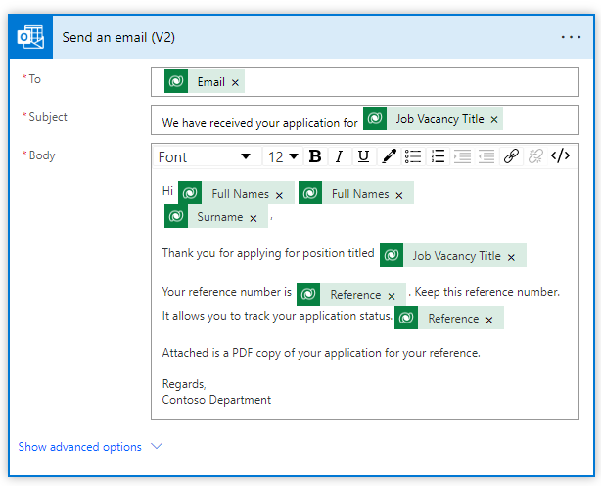
#4 – Edit Generate Z83 Document Flow
Edit the send an email step to change the format of the email sent to applicant.
Note – it only sends email if the applicant put in an email address in their application form

Slide 10
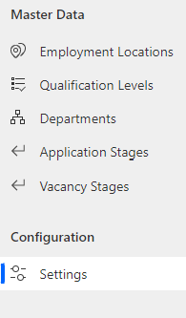
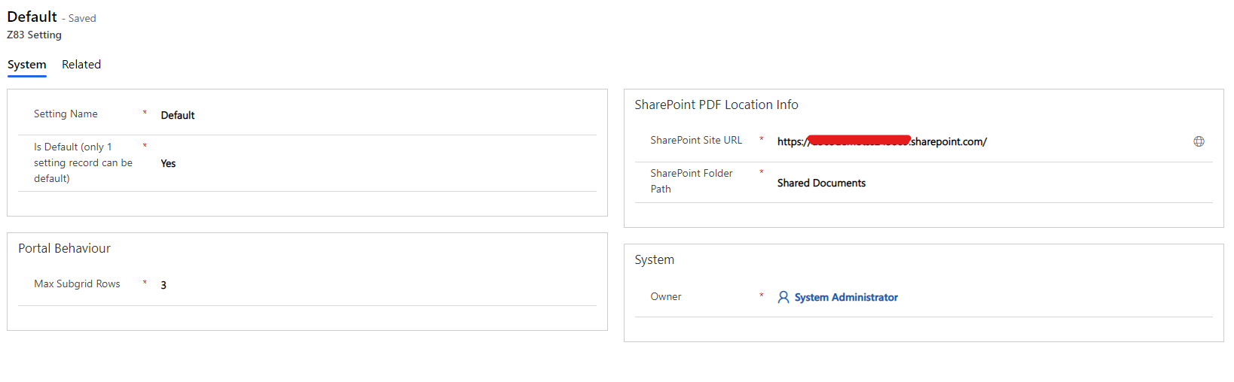
#5 – Configure other parameters / master data
Using settings section
Add department names which could be used as the owning department of a job vacancy
Add locations where a job vacancy could indicate is a location of employment e.g. Head Office, Pretoria
Settings heading in setting section
This is currently not used, the SharePoint paths are not used from here. However, it is a good idea to add the paths you used in the Z83 create document flow so that people know what was used.
In the future these settings might be used, and more settings added.
Not used

Slide 11
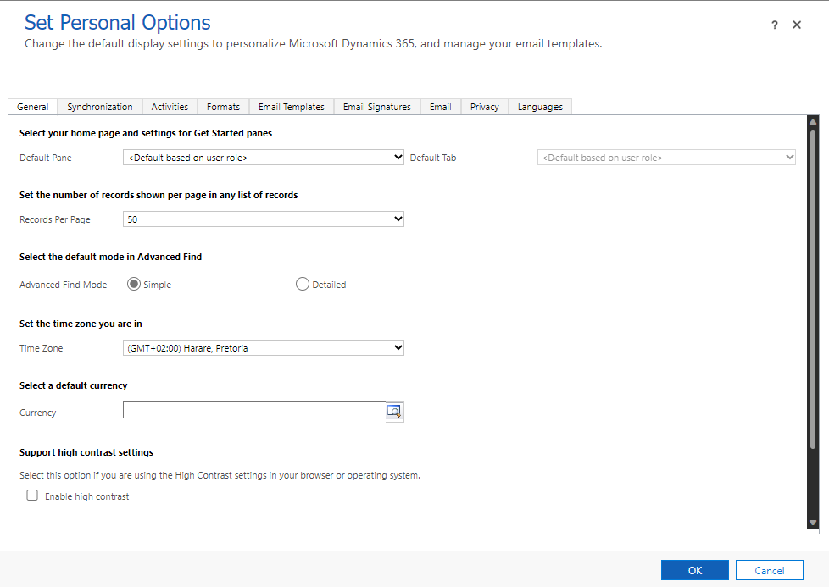
#5 – Configure other parameters / master data
For each user of the system, ensure in the Z83 manager they hit the gear (settings) icon in top right corner of scree, select “personalisation settings” and set their time zone to UTC +2 Harare.

Slide 12
#6 – Permission Setup
This needs work to define who needs what role / permission

